Slide 1



OSI Model Course Name: Data Communication & Network Course Code: R1UC406B Instructor Name: Priyanka Behera

Slide 2

Recap:
Q1. Difference Between LAN, MAN and WAN.
Q2. Which network is commonly used in a computer laboratory?
a) WAN b) LAN c) MAN d) Internet
Q3. Which of the following uses public communication lines?
a) LAN b) WAN c) PAN d) Bluetooth

Slide 3


Please Think How Data is communicated over network?
Ask guiding questions to the students.
Try to relate with topic.

Slide 4
At the end of this session students will be able to
Learning Outcome 1: Define the OSI Model and its seven layers
Learning Outcome 2: Understand the functions of each layer

Slide 5
Session Outline
1 Introduction
2
What is an ISO-OSI model?
3 Different Layers of OSI
4 Functionality of Layers
5 Conclusion

Slide 6

Can You guess the process of sending a letter to a friend?
Can you

Slide 7
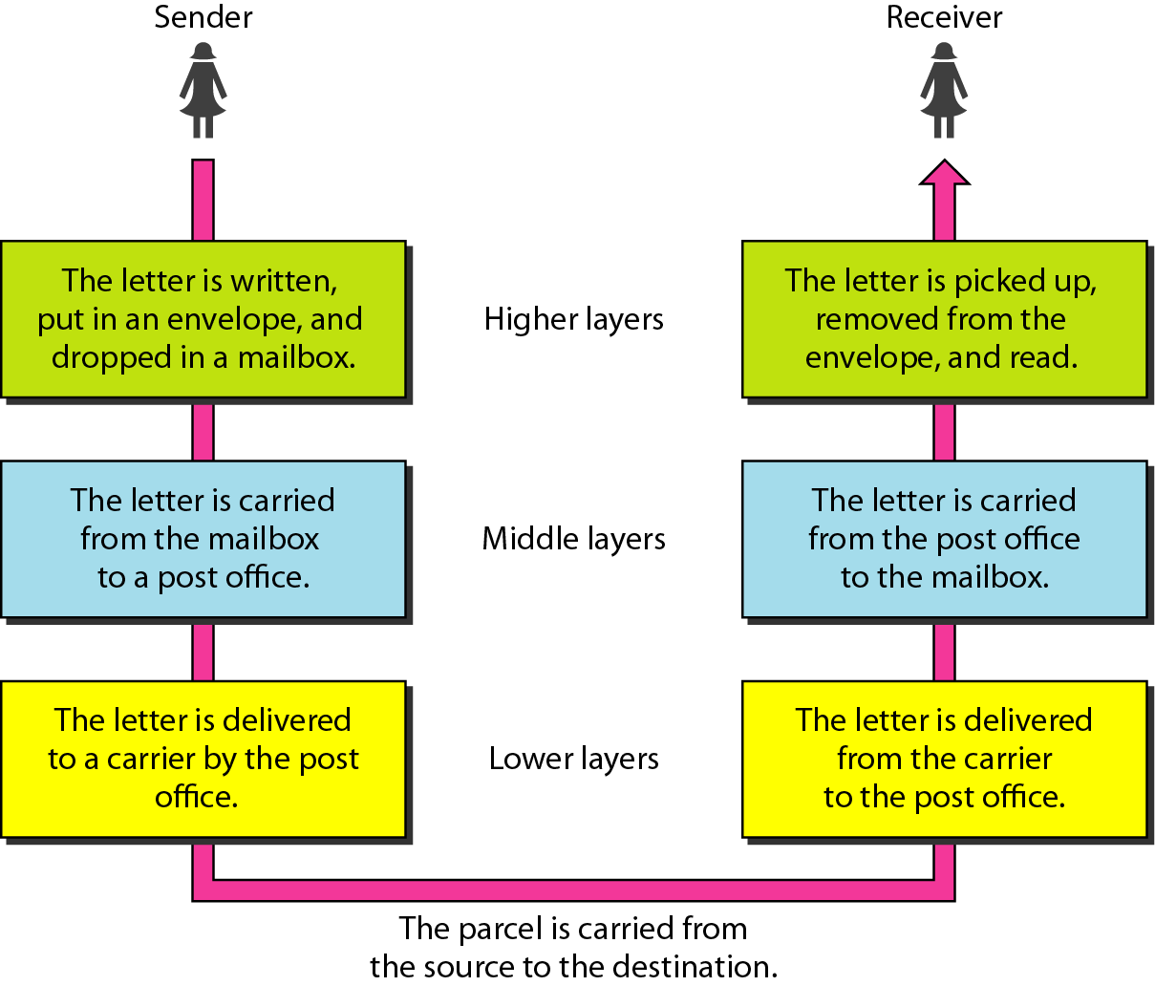
Task involved in sending a letter

Slide 8
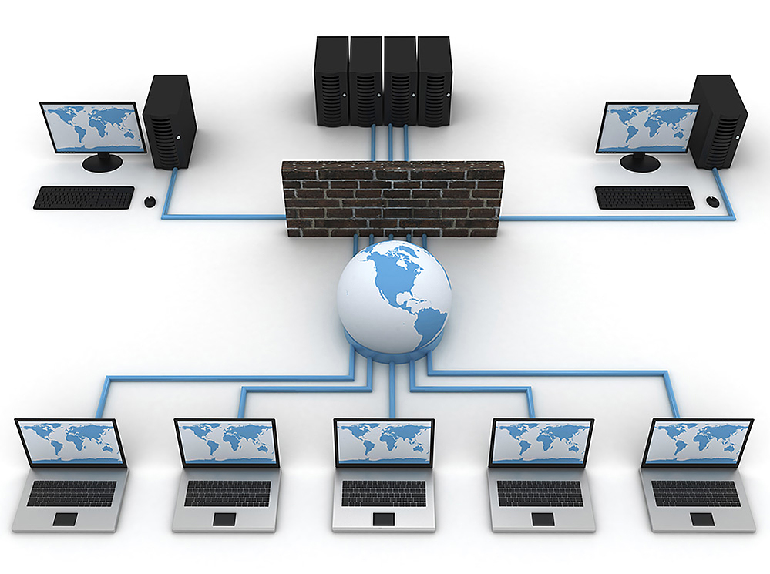
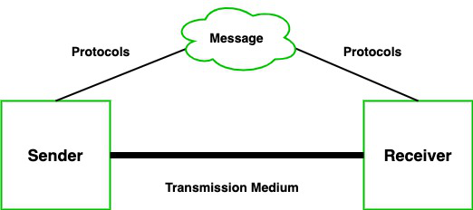

Slide 9
Reference Models- This tells how and where to implement different functionalities for data communication. Some examples are ISO-OSI, TCP/IP, IEEE, etc.

Slide 10
ISO-OSI
Established in 1947, the International Standards Organization (ISO) is a multinational body dedicated to worldwide agreement on international standards.
An ISO standard that covers all aspects of network communications is the Open Systems Interconnection (OSI) model. It was first introduced in the late 1970s.

Slide 11

Activity 1: Brainstorming
OSI model has seven layers.
The advantages of layering are as Abstraction, Encapsulation, Divide and Conquer, Simplified Testing, Modularity
Each team will brainstorm on one of the above highlighted advantage and justify how???

Slide 12
Layers
Layer 7
Application Layer
Layers 1-4 relate to communications technology.
Layers 5-7 relate to user applications.
Layer 6
Presentation Layer
Layer 5
Session Layer
Layer 4
Transport Layer
Layer 3
Network Layer
Layer 2
Data Link Layer
Layer 1
Physical Layer
Communications subnet boundary

Slide 13
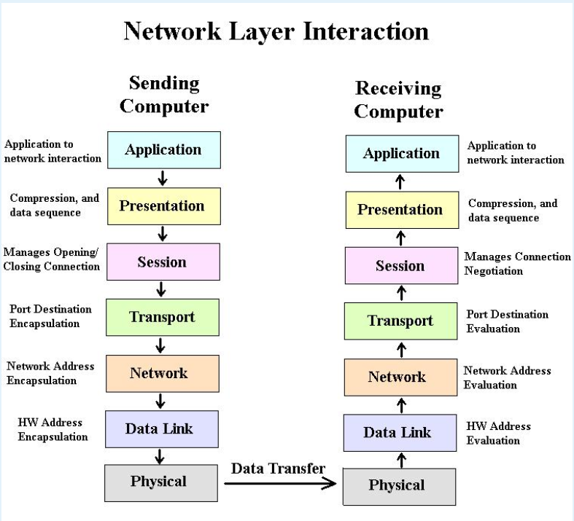

Slide 14
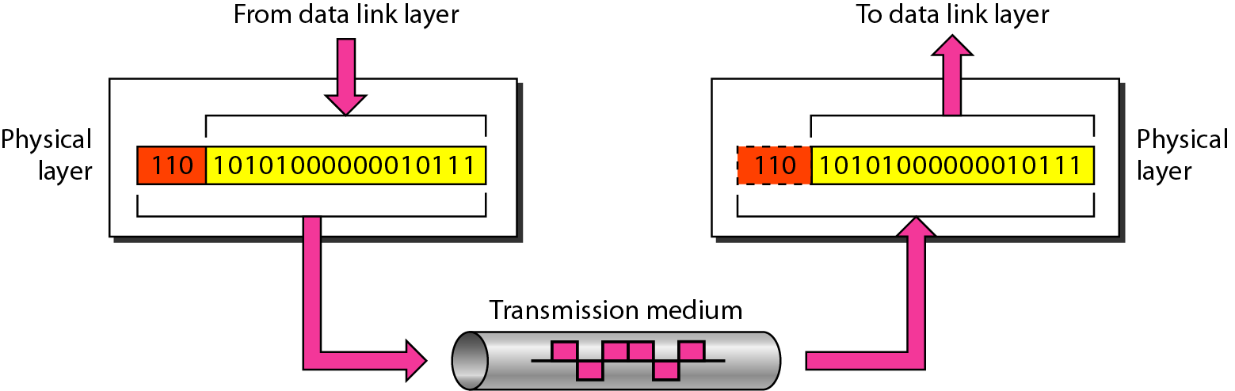
Physical Layer
The physical layer is responsible for movements of individual bits from one hop (node) to the next.

Slide 15
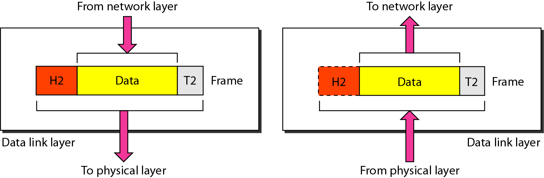
Data Link Layer
The data link layer is responsible for moving frames from one hop (node) to the next.

Slide 16
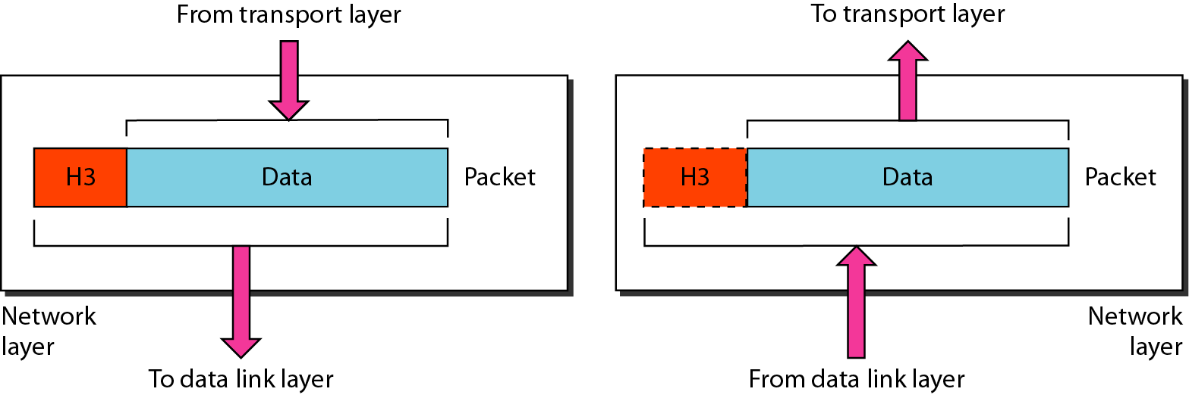
Network Layer
The network layer is responsible for the delivery of individual packets from the source host to the destination host.

Slide 17
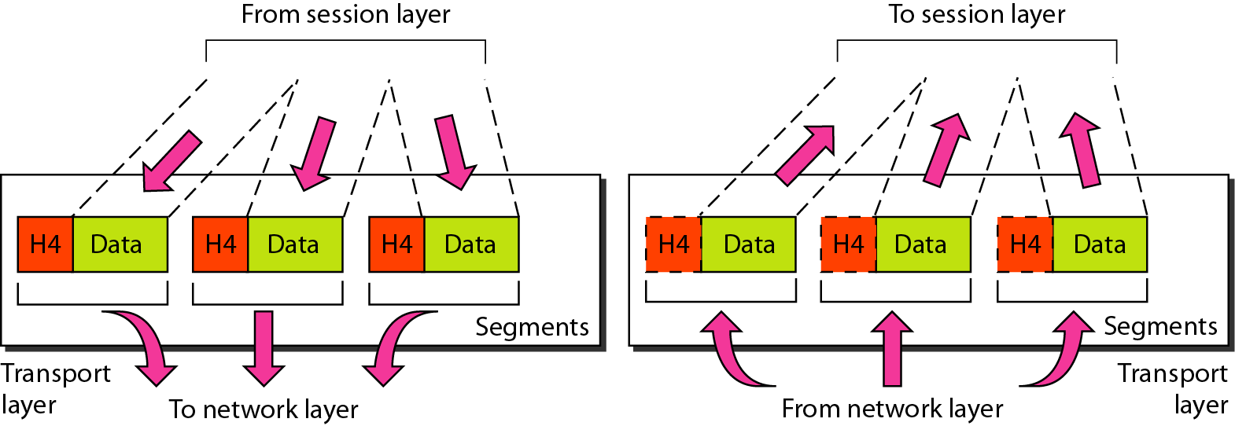
Transport Layer
The transport layer is responsible for the delivery of a segment from one process to another.

Slide 18
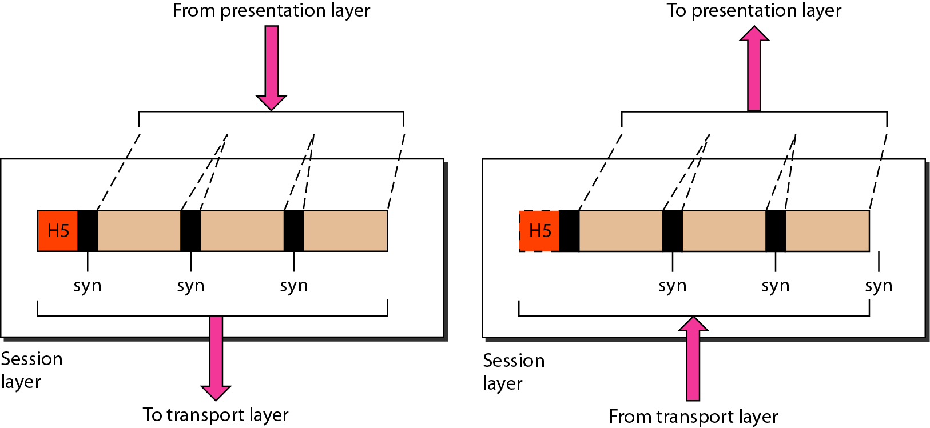
Session Layer
The session layer is responsible for dialog control and synchronization.

Slide 19
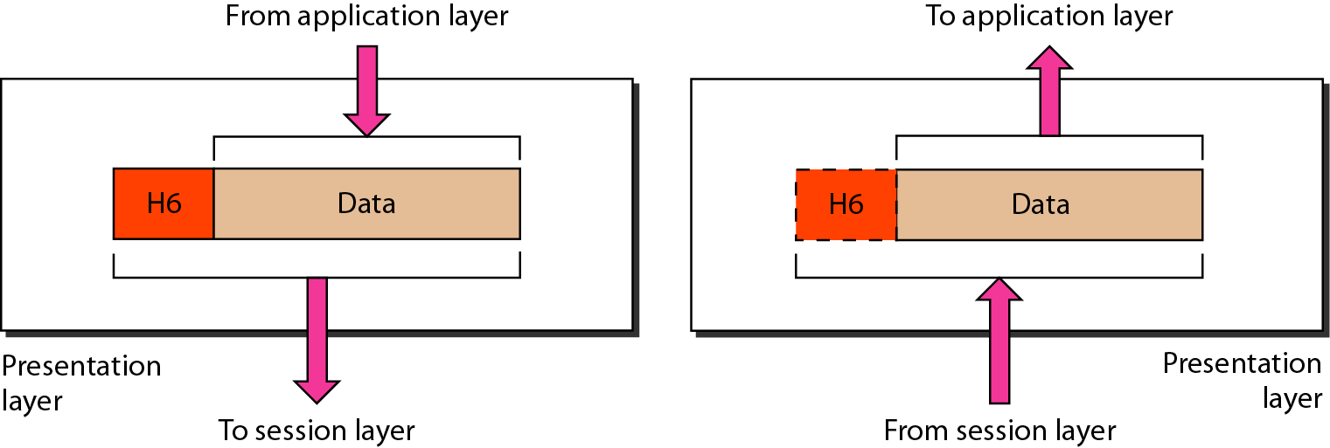
Presentation Layer
The presentation layer is responsible for translation, compression, and encryption.

Slide 20
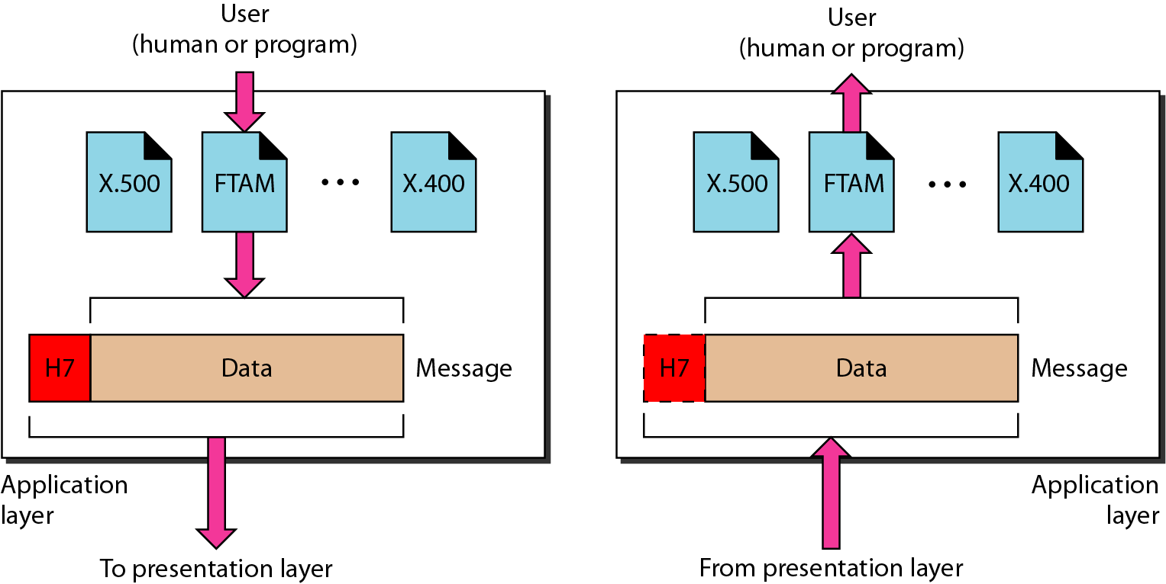
Application Layer
The application layer is responsible for providing services to the user.

Slide 21
Activity 2: Jigsaw
Each team will discuss on an assigned layer and discuss.
Research and present key functions.
Discuss real-world examples of your assigned layer

Slide 22

Activity 3: Match the following

Slide 23
Conclusion
OSI is a reference model that has seven layers.
Each layers replicates an abstract, encapsulated and modular way to transmit data over the network.
Each layer has their unique functionality such as network layer do routing, physical layer is for handling physical device and so on.

Slide 24
Ensure attainment of LOs in alignment to the learning activities: outcomes (1-2)
Outcome 1: Activity 1 explained benefits of having layer based OSI model
Outcome 2: Activity 2 &3 explained functionality of each layers of OSI model

Slide 25
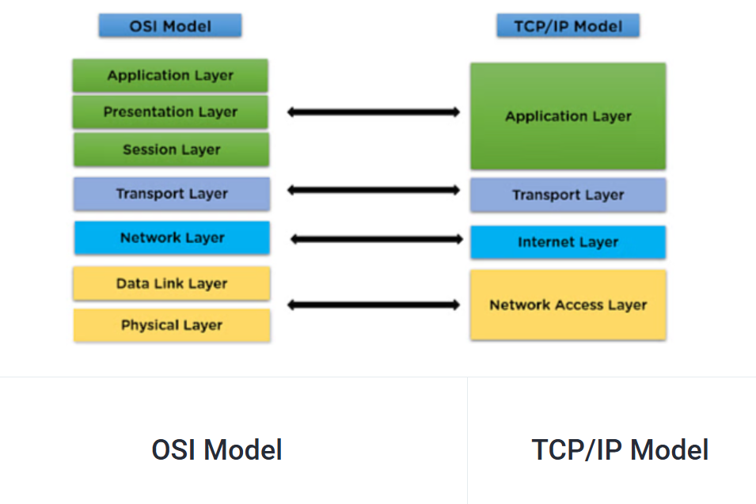
Next we are going to start about..... TCP/IP Protocol Suite

Slide 26


Review and Reflection from students

